Slide 1
IT Planning Forecasting Best Practice
Steve Tarrant
Consulting Manager
15th May 2019

Slide 2
Agenda
Poll Responses
About Budgets and Forecasts
Forecast Plan Preparation
Running the Forecast
Demonstration

Slide 3
Poll Responses

Slide 4
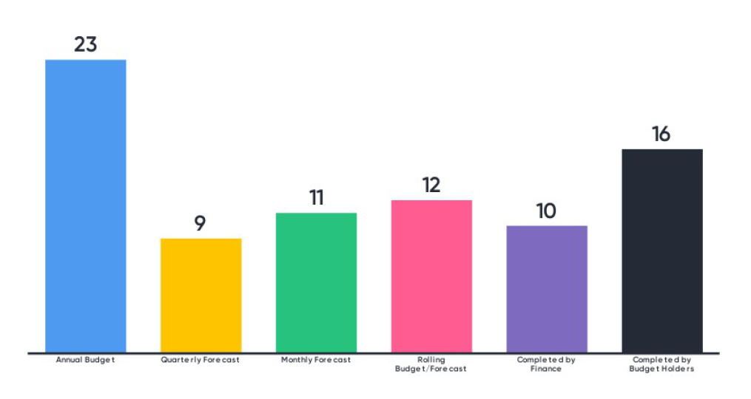
What Budget / Forecast processes do you run?

Slide 5
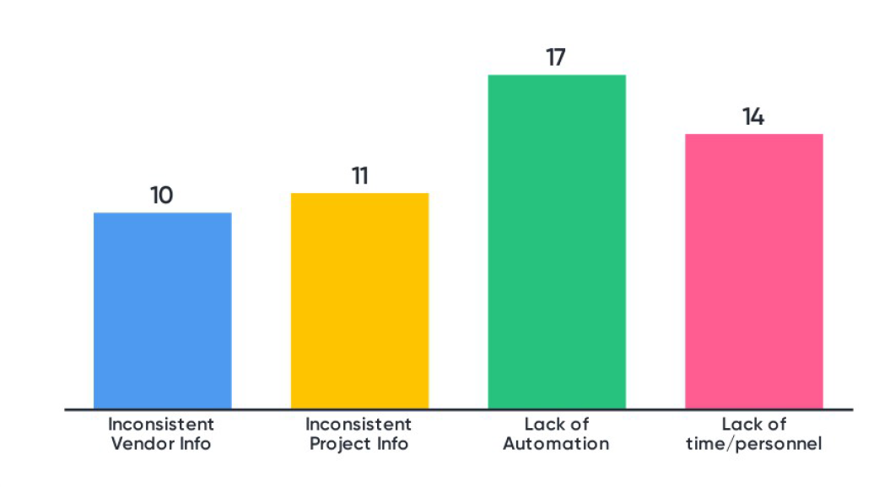
What difficulties do you have in running your forecasts?

Slide 6
About Budgets and Forecasts
What is forecasting?
What are Budgets and Forecasts in Apptio?
Why run a forecast process?
How IT Planning makes this easier
Notes:
What is forecasting?
A financial forecast is an estimate of future company income and expenses which is used for projections of profit and loss, cash flow and balance sheets etc.
What are Budgets and Forecasts in Apptio?
Both are financial forecasts but Apptio views Budget as the financial forecast for the next financial year whilst a Forecast is the outlook for the current financial year. This distinction is also reflected in how IT Planning creates Forecasts which I will cover in the next slide.
Why run a forecast process?
These financial forecasts allow monitoring of planned spend and provide control and governance for company expenditure. A forecasting process can identify over-spends and under-spends which can indicate problems in the organization and also identify unused budget that could be used on other projects and initiatives.
An import aspect of forecasting is to pass accountability to the people responsible for spending the money as they know the detail of what is being spent. This keeps financial plans current and up to date with the latest developments.
How IT Planning makes this easier
IT Planning provides a level of automation for reporting and workflow. It provides one source of truth rather than having multiple spreadsheets and its in-built reporting makes comparisons and variance analysis far easier than using spreadsheets.
ITP also allows additional granularity which is required to manage the complexities of running an IT department rather than the summarised view of expenses often provide by corporate planning systems.
Using ITP should reduce the effort and elapsed time for budgeting and make more frequent forecasting cycles much more feasible.

Slide 7
Forecasting in IT Planning
2019 APRIL FORECAST
JAN | FEB | MAR | APR | MAY | JUN | JUL | AUG | SEP | OCT | NOV | DEC
Actuals
Spend Management
JAN
MAR
FEB
2019 BUDGET
JAN | FEB | MAR | APR | MAY | JUN | JUL | AUG | SEP | OCT | NOV | DEC
APR | MAY | JUN | JUL | AUG | SEP | OCT | NOV | DEC
Notes:
A budget plan starts with figures taken solely from the baseline plan whereas a forecast contains actuals for previous periods || and then baseline figures to the end of the year. ||
This allows us to do comparisons and variance analysis of actuals against plan || and then re-estimate the costs for the remainder of the year. ||
Actuals are loaded as read only so only the remaining months’ figures can be changed.
Also the variance analysis functionality is available for forecast plans whereas it is not applicable to budget plans.

Slide 8
Forecast Preparation & Execution

Slide 9
Forecasting Preparation (1)
Update reference data:
Departments, Projects, Accounts etc.
Variance Drivers – set categories for variance analysis
Load actuals
Ensure required actuals are loaded
Do actuals contain vendor and project details? Are these included in your baseline budget or forecast?
Set Targets
Update Cost Object permissions
Create forecast plan
Set Variance Analysis limits

Slide 10
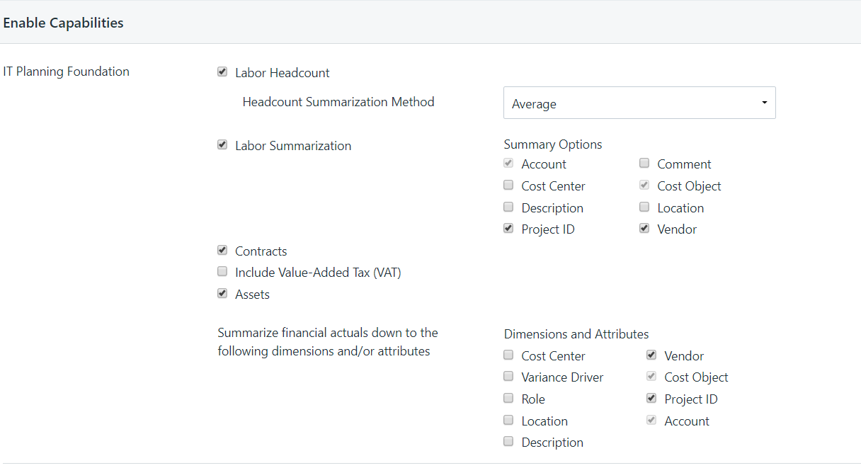
Forecasting Preparation (2)

Slide 11
Running the Forecast
Ensure all budget / cost center owners know when they need to complete their forecasts
Ensure they are reminded of any changes to process since the last forecast run
Consider refresher training for existing or full training for new personnel
Give users someone to call for support – shared mailbox?
NOTE – Automated emails
Open the plan
Notes:
Plan Open Event Communications
In the Cost Object Permissions it is only people listed at the bottom level in the hierarchy that will receive an automated email when the plan is opened.
People that have permissions cascaded to lower levels won’t receive an open email.
The recommendation is to switch off “emails for planning process events” in the Company Profile. Replace this with a manual email sent to all budget and cost center owners. Once the plan is opened then switch on the planning process emails so that people are notified when people submit or reject plans.

Slide 12
Variance Analysis

Slide 13
Variance Analysis – What are we looking for? (1)
Over-spent versus under-spent budget
Advise budget holders to focus on key areas to aid analysis
Over-spent lines due to:
Higher demand → pass costs to BUs?
Projects taking more resource than planned → assess project progress
Unexpected Vendor spend → additional needs identified?
Where the spend trend is too fast
Investigate → gather reasons e.g. varied demand from plan, delayed projects etc.

Slide 14
Variance Analysis – What are we looking for? (2)
Under-spent lines due to:
Vendor spend → Check contracts → resolve / re-phase?
Unused budget e.g. internal labor → Investigate → resolve?
Underspent projects → Investigate → resolve / re-phase?
Unspent CapEx → Check project status?
Where the spend trend is too slow
Investigate → gather reasons e.g. varied demand from plan, delayed projects etc.

Slide 15
Demo

Slide 16
THANK YOU

